Slide 1
#5 – LIS Database Access
Nick Brown

Slide 2

A metaphor for database access…
Getting data from a database is like ordering your data from a warehouse…

Slide 3

Relational databases
Relational databases are computer systems that specialize in storing, managing, and retrieving data.

Slide 4
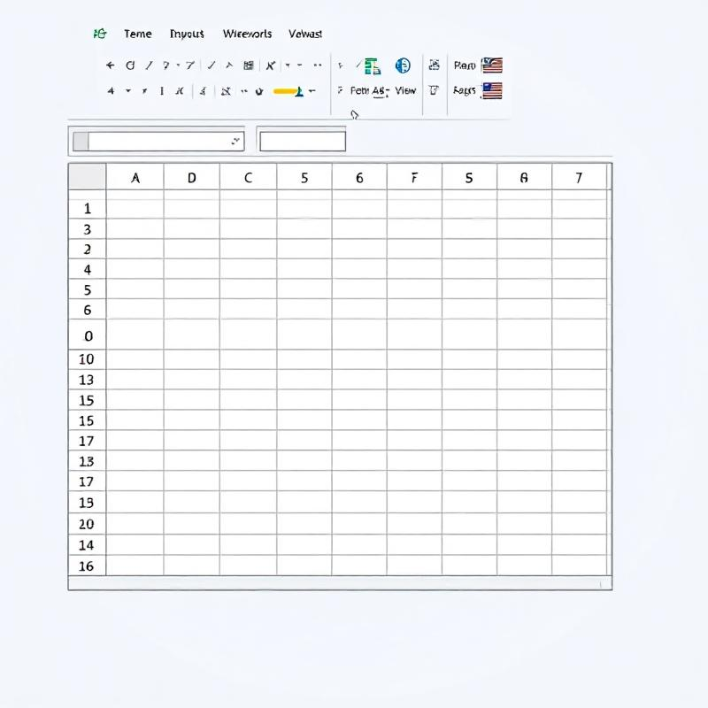
Tables in a relational database
Relational databases store data in several tables, like having a spreadsheet with data in different tabs.

Slide 5
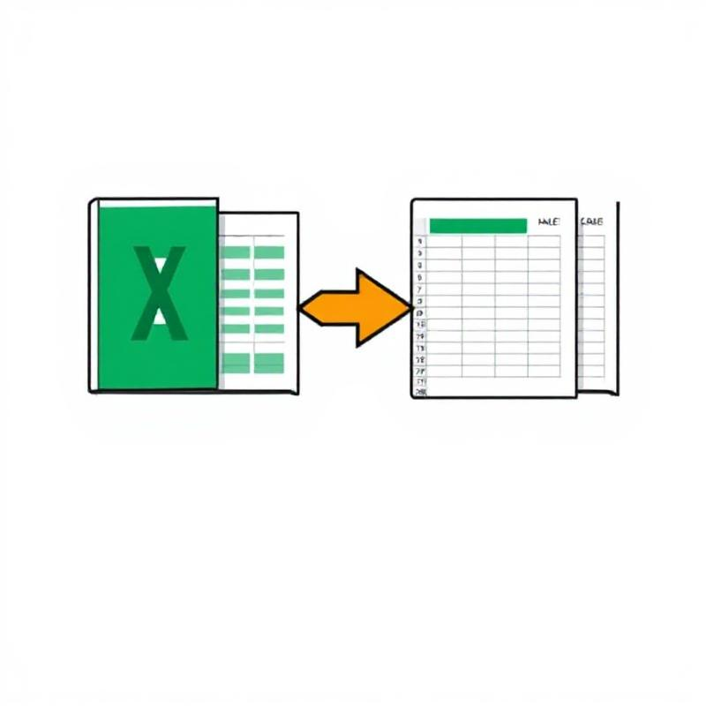
Relational data
Data between the tables correspond to each other by relations. These relations can be used to join data between tables.

Slide 6
Ordering data from a database
Ordering data from a database requires the use of the SQL computer language – the only language databases understand.

Slide 7
Ordering data from a database
Once you place your order for data from a database, you collect it, or have it shipped to you.

